Slide 1
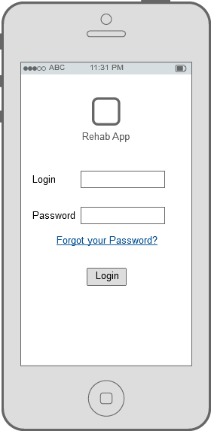
Interactive rehabilitation App
Guiding In-Home
Rehabilitation Exercises

Slide 2
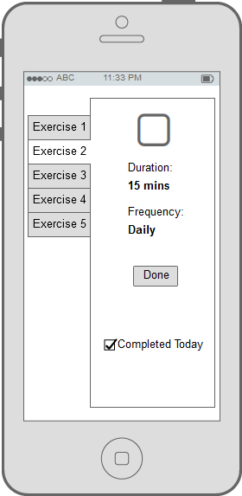
Dual Interface App
Patient Interface
Content Dynamically Prescribed by Healthcare Provider
Multiple Exercise Options
Animated Exercise Guides
Prescribed Intensity and Frequency
Confirmation of Completed Tasks
Youtube link to instruction
video
Button to mark exercise is
Done.

Slide 3
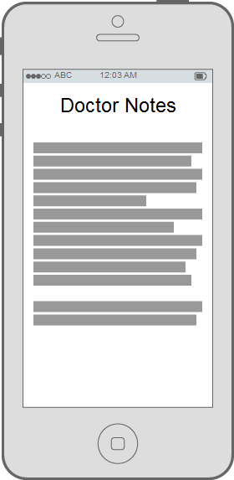
Additional information provided by doctor in a notes section

Slide 4
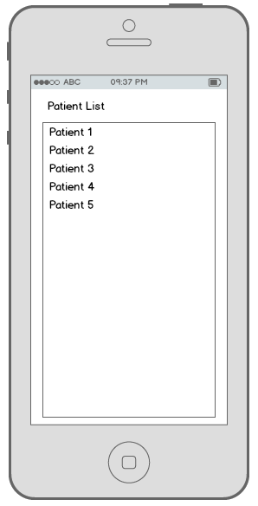
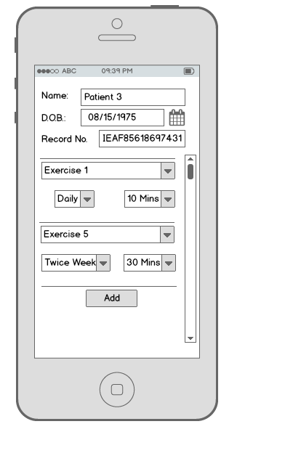
Doctor Interface
List of Patients
List of Exercises
Reports for Tasks Completed for Patient Profiles
Control over Intensity and Frequency for Exercises

Slide 5
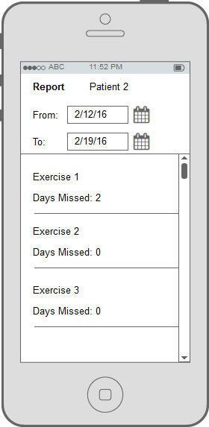
Exercises/Tasks Updated at Doctor’s Visit
VistA compatible backend database
Patient exercise report

